Slide 1


Joyal Jose
3/24/2024

Slide 2

Outline
Executive Summary
Introduction
Methodology
Results
Conclusion
Appendix

Slide 3
Executive Summary
Methodologies:
To understand more about SpaceX launches, data was pulled from Wikipedia and the original SpaceX site that provided quantitative and qualitative documentation of successes and failures. The raw data was then cleaned and properly defined to numerically define categorical values. A plotly dashboard was used ot visualize the data and exploratory data analysis was conducted on Python and SQL to understand how the to platforms interact with data. From there, Data was then scaled and split not training and setstign sets to be inputted into various classifcaiotn models. These models were then optimized for the best prameters and obtain anaccrucy score per each model. The overall results found various confusion matrices with the Decision Tree classfierhaving the best model. Its accuracy was of a 87% with the following parameters.
Summary of methodologies
Summary of all results

Slide 4
Introduction
SpaceX advertises Falcon 9 rocket launches on its website with a cost of 62 million dollars; other providers cost upwards of 165 million dollars each, much of the savings is because SpaceX can reuse the first stage. Therefore, if we can determine if the first stage will land, we can determine the cost of a launch. Problems you want to find answers
My job is to determine the price of each launch. I will do this by gathering information about Space X and creating dashboards for your team. I will also determine if SpaceX will reuse the first stage. Instead of using rocket science to determine if the first stage will land successfully, you will train a machine learning model and use public information to predict if SpaceX will reuse the first stage.

Slide 5

Section 1

Slide 6
Methodology
Executive Summary
Data collection methodology:
The data utilized ws found through two main sources:
SpaceX REST API
Wikipedia – Beautiful Soup
Perform data wrangling
Data was fist identified for missing values and filled in with the mean of the feature, dependant on the distribution shape. Each feature was then asses for the counts and uniqueness of each value. Features were then assess for types and converted all features to fit a numeric scale using OneHotEncoder (.get_dummies())
Perform exploratory data analysis (EDA) using visualization and SQL
Perform interactive visual analytics using Folium and Plotly Dash
Perform predictive analysis using classification models
How to build, tune, evaluate classification models

Slide 7
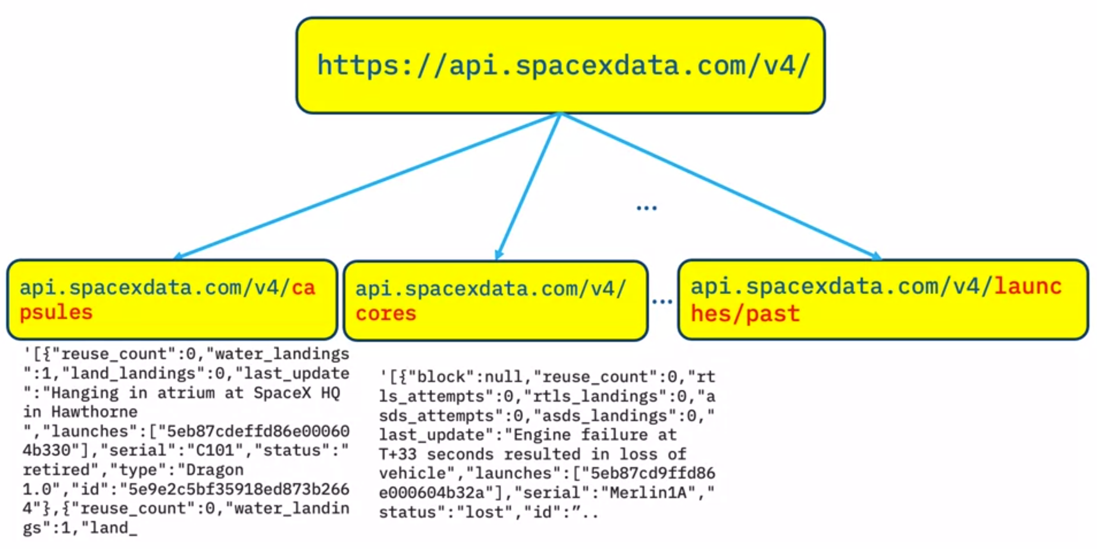
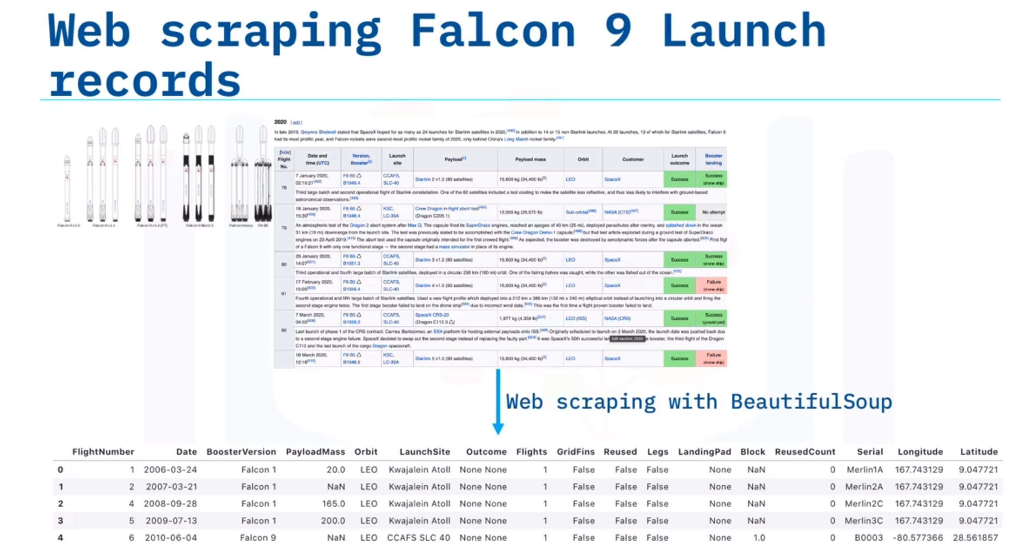
Data Collection
For the Space X API, the URL is used to target a specific endpoint of the API to get past launch data. A get request is preformed using the requests library to obtain the launch data, which we will use to get the data from the API. This result can be viewed by calling the .json() method. The response will be in the form of a JSON, specifically a list of JSON objects. Since we are using an API, it’s noticed in the lab that when we get a response it is in the form of a JSON. Specifically, a list of JSON objects which each represent a launch.
For Wikipedia, Python BeautifulSoup package is used to web scrape some HTML tables that contain valuable Falcon 9 launch records. Then you need to parse the data from those tables and convert them into a Pandas data frame for further visualization and analysis.

Slide 8
Data Collection – SpaceX API
Request and initialize data from SpaceX website
Define and fill global variables from various sites
Filter the dataframe to only include `Falcon 9` launches
Keywords:
Define URL
Response: requests.get()
Confirm Status: .status_code
Json to Pandas DF : .json_normalize()
Keywords:
Define functions to parse data from various sub-websites for more data
Initialize global variables
Call functions to populate global variables
Keywords:
Use pd.dataframe.loc[] to gather all rows pertaining to falcon 9 booster versions and initialize/populate new df variable
https://github.com/Hosoyo1/Capstone-for-IBM-Data-Science/blob/b624a663faef5dd2434e18b54da2ca9ccf0aa2fe/More%20Data%20Collection.ipynb

Slide 9
Data Collection - Scraping
Request the Falcon9 Launch Wiki page from its URL
Extract all column/variable names from the HTML table header
Create a data frame by parsing the launch HTML tables
Keywords:
Define URL
Response: requests.get()
Create Beautiful Soup Object from response.text
Keywords:
Find all tables: soup.find_all('table’)
Initalize lists for column names
.find_all(‘th’) and extract column from header
Keywords:
Initialize global variables
Run try/expect loop to input alues where a cell in a wk9ipedi tale is populated
https://github.com/Hosoyo1/Capstone-for-IBM-Data-Science/blob/b624a663faef5dd2434e18b54da2ca9ccf0aa2fe/Web%20Scraping%20for%20Data%20Collection.ipynb

Slide 10
Data Wrangling
Calculate the number of launches on each site
Calculate the number and occurrence of each orbit
Create a landing outcome label from Outcome column
Calculate the number and occurence of mission outcome of the orbits
Keywords:
.value_counts()
Keywords:
.value_counts()
Keywords:
.value_counts()
Keywords:
Initalize list for binary class value
Define variable as 0 if bad outcome occured, otherwise 1
Append value to list
All features were reviewed for value counts and uniqueness.
https://github.com/Hosoyo1/Capstone-for-IBM-Data-Science/blob/1c4a38fb1b4823976c7d26e41183f9f3581e787c/jupyter-labs-webscraping%20(1).ipynb

Slide 11
EDA with Data Visualization
The primary charts utilized are scatter plots, bar charts like histograms and line charts.
Scatter Plots were used to determine a relationship/correlation between two variables
Histograms were used to see categorical data paired with continuous variables to identify frequencies
Line Charts wee used to see changes in an average value over time
https://github.com/Hosoyo1/Capstone-for-IBM-Data-Science/blob/b624a663faef5dd2434e18b54da2ca9ccf0aa2fe/EDA%20on%20Python.ipynb

Slide 12
EDA with SQL
The Primary types of uses made were DML that focused on selecting certain values of scalar or an nth dimensional datasets.
Some examples include:
Display Avg Payload Mass by Booster F9 v1.1
When successful outcome ws first achieved
List the records which will display the month names, failure landing_outcomes in drone ship ,booster versions, launch_site for the months in year 2015.
https://github.com/Hosoyo1/Capstone-for-IBM-Data-Science/blob/b624a663faef5dd2434e18b54da2ca9ccf0aa2fe/EDA%20on%20SQL.ipynb

Slide 13
Build an Interactive Map with Folium
Created a map with circle areas to identify all launch site zones.
Used markers to identify launch site locations
Created a Marker cluster to identify successes and failures within each launch site
Used mouse position to identify how far a targeted area would be to a designated launch site
https://github.com/Hosoyo1/Capstone-for-IBM-Data-Science/blob/b624a663faef5dd2434e18b54da2ca9ccf0aa2fe/Folium%20Visual%20Analytics.ipynb

Slide 14
Build a Dashboard with Plotly Dash
Used Pie charts to identify the difference between the classes of landing outcomes
Created a filter for each launch site to identify different success rates
Used scatter plots to identify how payload mass and # of flights were related with reference to landing outcomes
Allowed the filter for payload mass throughout the years
https://github.com/Hosoyo1/Capstone-for-IBM-Data-Science/blob/b624a663faef5dd2434e18b54da2ca9ccf0aa2fe/Visual%20Analysis%20with%20Dashboard.ipynb

Slide 15
Predictive Analysis (Classification)
Assign variables, standardize, and split data for testing/training
Define Parameters and initial model
Define GridSearch and identify best scores and parameters
Define score and construct confusion matrix
Keywords:
Define independent variables as X and dependent as Y
use StandardScalar() to fit_transform(X)
Use train_test_split to create train/test data
Keywords:
Set parameters equal all possible options for the initial model with respect to scope
Call model initialization per respective algorithm
Keywords:
GridSearch(model,cv=10,param_grid = parameters)
Best Parameters : .best_params
Best score : .best_score_
Keywords:
Score = GridSearch variable .score(X_test,y_test)
Yhat = .predict(y_test)
Confusionmtrix(y_test,yhat)
Model were built using common classification algorithms. To initiate, all independent features were standardize to minimize errors in uncalculating distance. Data was then split into training and set data. The train data would would then be fitted into each respective model and into a gird search to obtain the bets hyperparameters. All results were scored for accuracy and set into a confusion matrix for further analysis.
https://github.com/Hosoyo1/Capstone-for-IBM-Data-Science/blob/b624a663faef5dd2434e18b54da2ca9ccf0aa2fe/SpaceX%20ML%20Prediction.ipynb

Slide 16
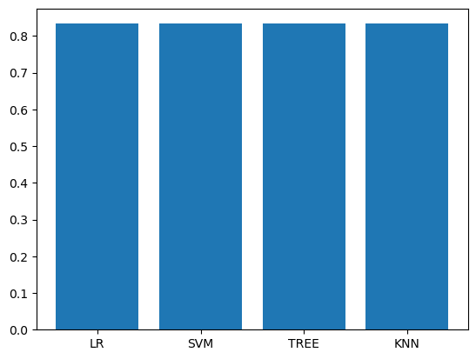
Results
Decision Tree has the Accuracy vs confusion Matrix
Launch sites were located on the outer coasts of the US

Slide 17

Section 2

Slide 18
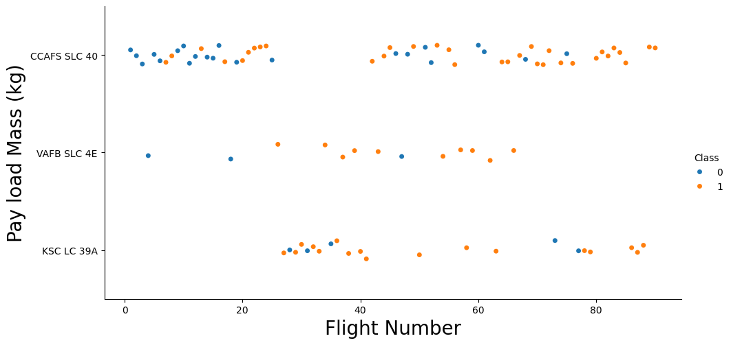
Flight Number vs. Launch Site
Shows the relationship between the Flight Number ( x-axis) and Launch Site ( y-site) with a hue based on successful launches
CCAF has had the most mount of tests but the other sites have a higher probability of success.
Once we have passe the 50 count the majority of flights

Slide 19
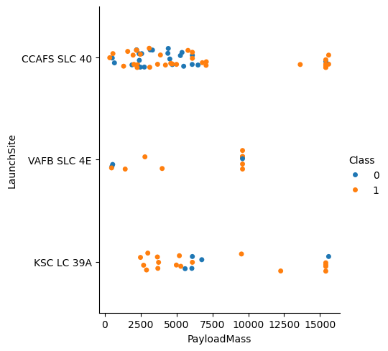
Payload vs. Launch Site
This shows the success rate between a launch site and the payloads mass
His figure shows that once a certain payload mass is reached the success ate greatly increases at around 8000 lbs.

Slide 20
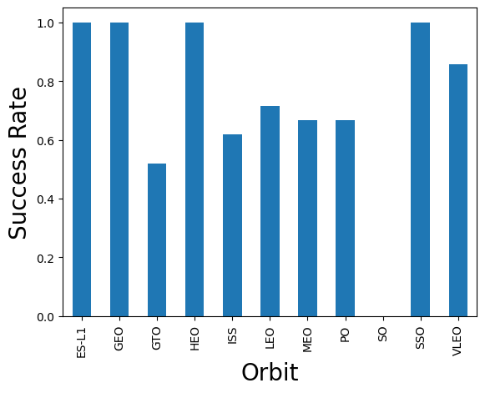
Success Rate vs. Orbit Type
We can see higher orbits have a higher rate of success
This isn’t dependent on sample size

Slide 21
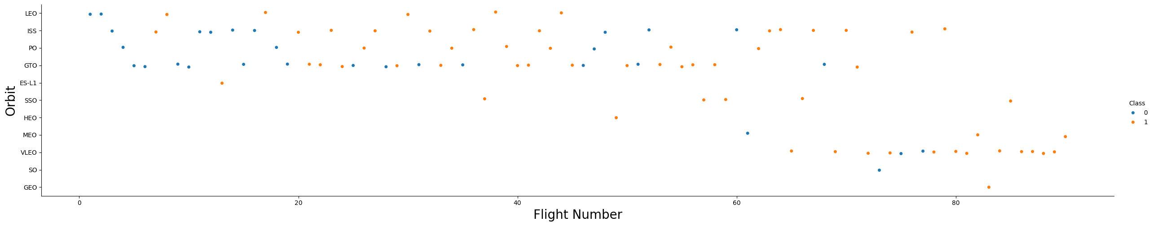
Flight Number vs. Orbit Type
Show a scatter point of Flight number vs. Orbit type with successes (orange) and failures (blue)
As number of flights increased, the success rate would improve

Slide 22
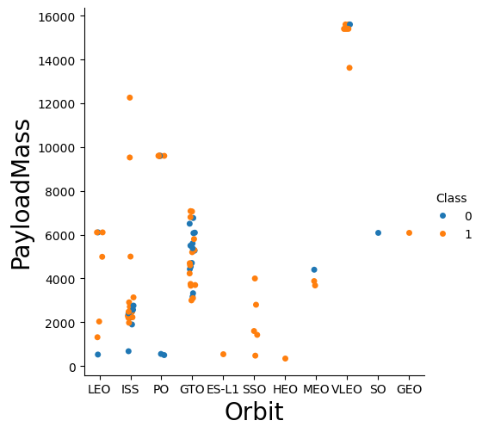
Payload vs. Orbit Type
This shows the relationship between the orbit type and the payloadmass used
For most orbits, using a paylod mass above 400 would be optimal outside of GTO orbti

Slide 23
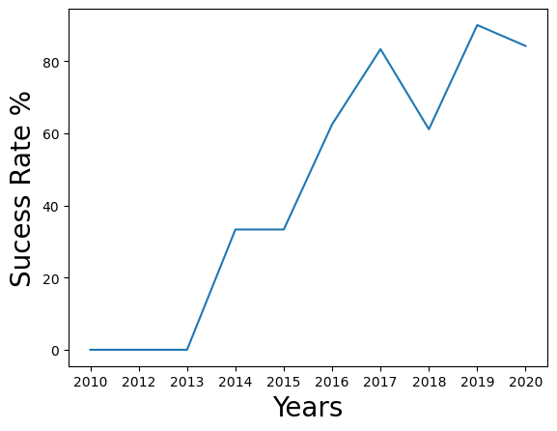
Launch Success Yearly Trend
This sows the average success rate over the years
There's been a steady linear incline followed by a plateau,. This then creates its local maxima in 2017 and local minima in 2018 and its peak in 2019 creating an improvement over the years.

Slide 24
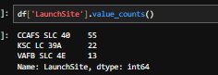
All Launch Site Names
There are only three primary Launch Sites with CCAFS having the most data

Slide 25
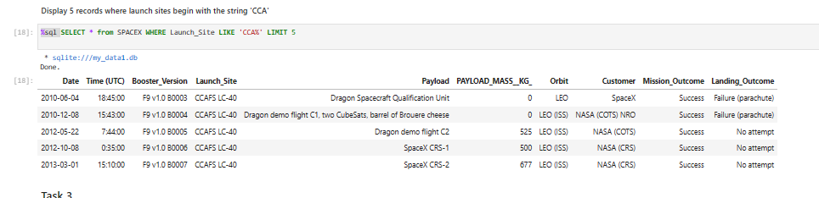
Launch Site Names Begin with 'CCA'
%sql SELECT * from SPACEX WHERE Launch_Site LIKE 'CCA%' LIMIT 5
Shows the first 5 unsorted rows of Launch Sites tht have the following values ‘CAA’

Slide 26
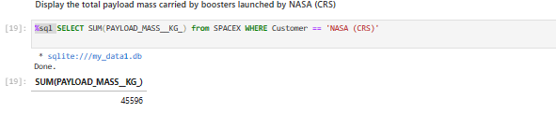
Total Payload Mass
Value of all the payload masses combined

Slide 27
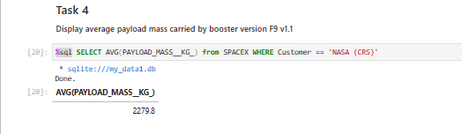
Average Payload Mass by F9 v1.1
Average value of payloads from NASA (CRS) customers

Slide 28
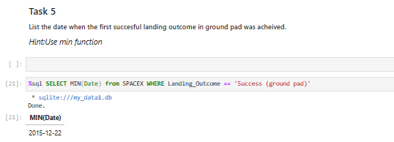
First Successful Ground Landing Date
Smallest date where the Outcome of the ground landing was successful

Slide 29
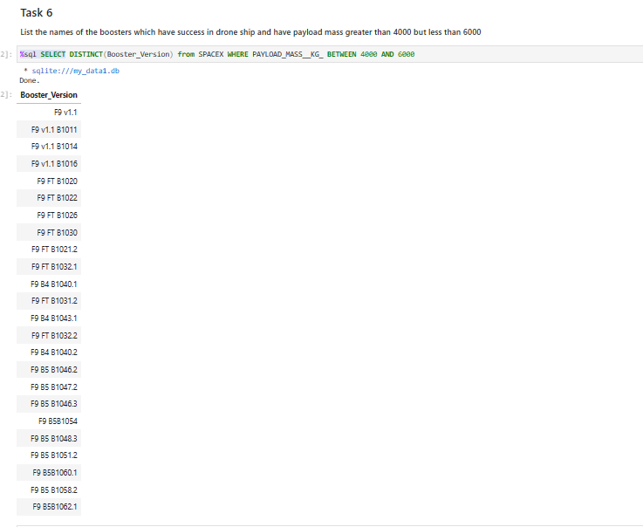
Successful Drone Ship Landing with Payload between 4000 and 6000
List the names of boosters which have successfully landed on drone ship and had payload mass greater than 4000 but less than 600

Slide 30
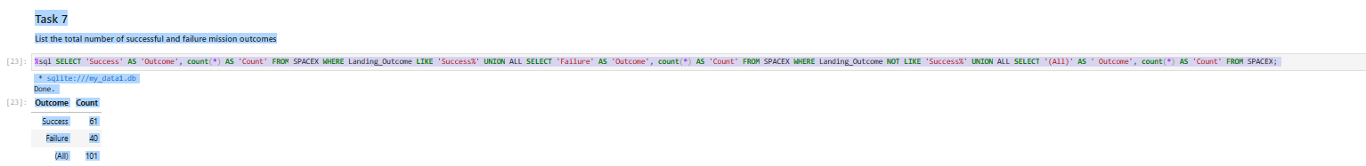
Total Number of Successful and Failure Mission Outcomes
Calculate the total number of successful and failure mission outcome

Slide 31
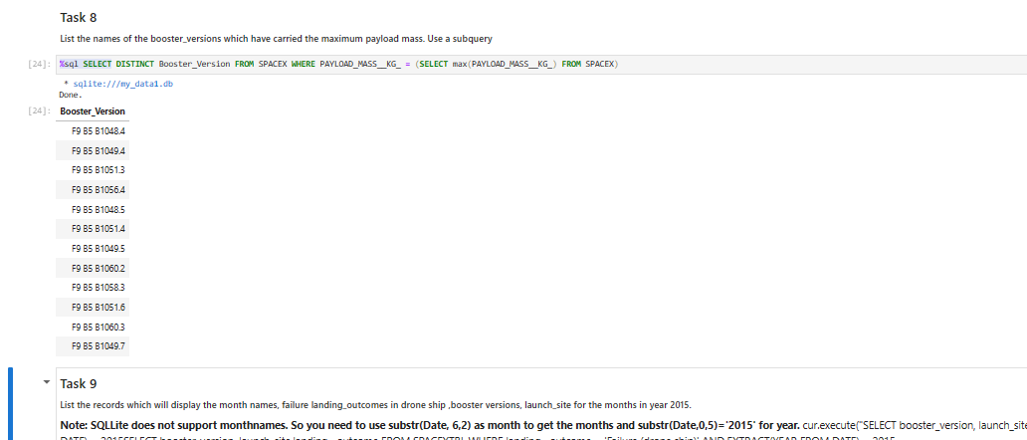
Boosters Carried Maximum Payload
List the names of the booster which have carried the maximum payload mass

Slide 32
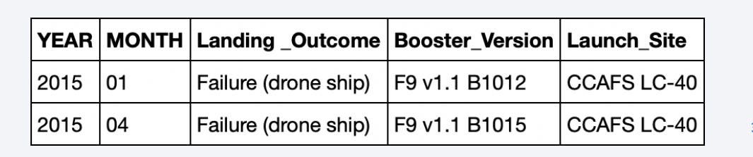
2015 Launch Records
List the failed landing_outcomes in drone ship, their booster versions, and launch site names for in year 2015

Slide 33
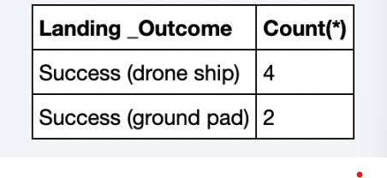
Rank Landing Outcomes Between 2010-06-04 and 2017-03-20
Rank the count of landing outcomes (such as Failure (drone ship) or Success (ground pad)) between the date 2010-06-04 and 2017-03-20, in descending order

Slide 34

Section 3

Slide 35
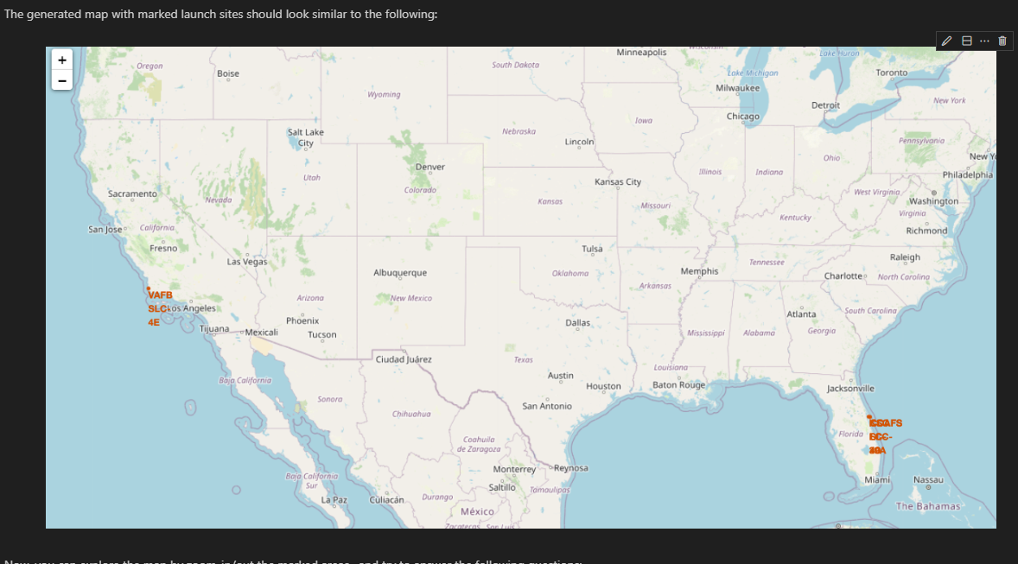
Mark all launch sites on a map
Sites are in LA and Florida, areas neat the coast

Slide 36
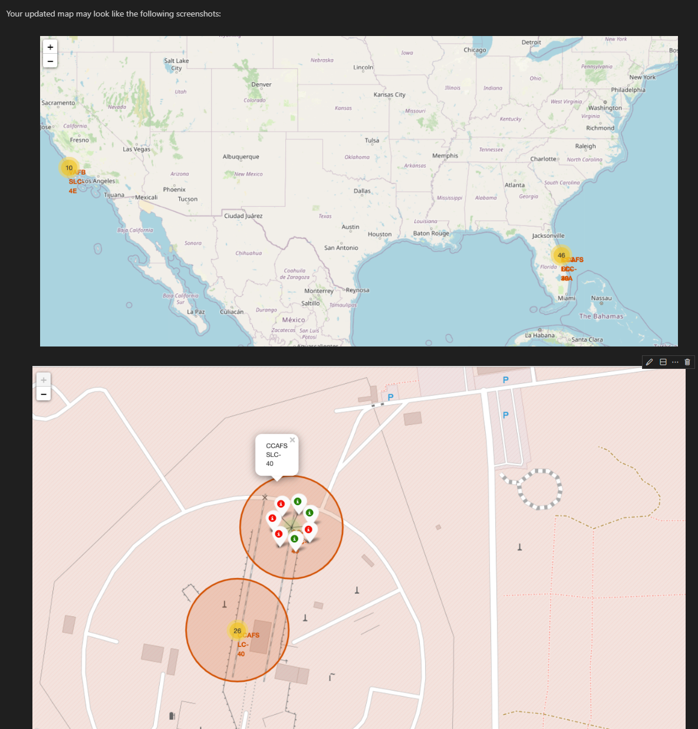
Mark the success/failed launche
Sorted areas with successes and failures using MarkerCluster

Slide 37
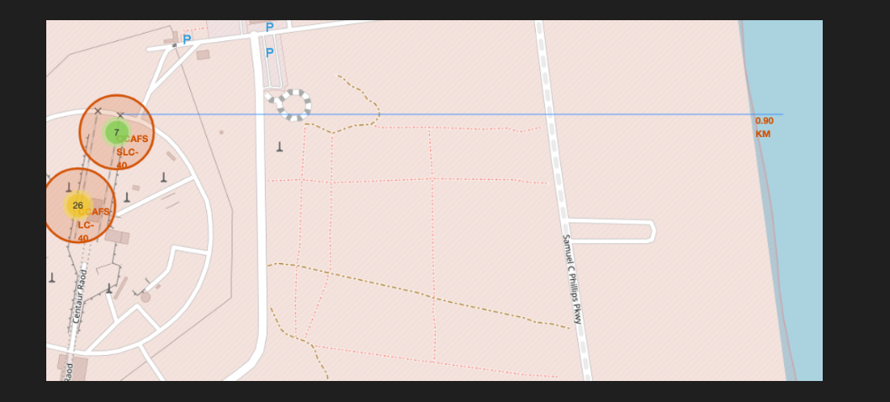
Calculate the distances between a launch site

Slide 38

Section 4

Slide 39
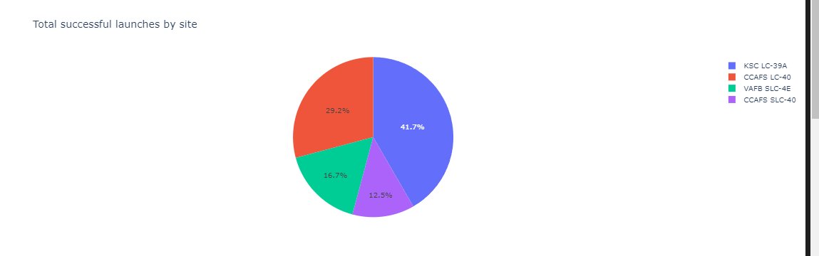
Successful launches by all sites
KSC Has the highest successful lunacges followed by CCAFS

Slide 40
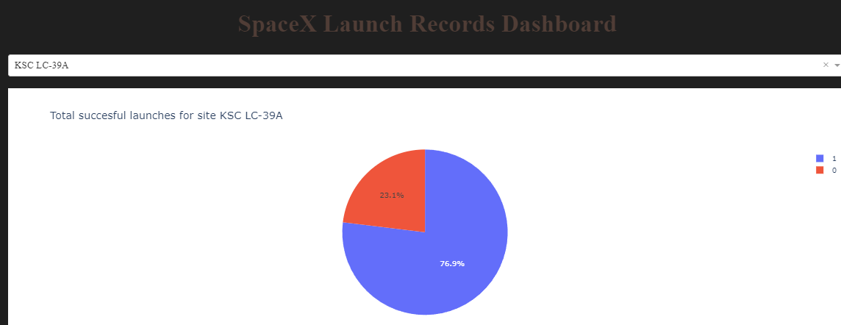
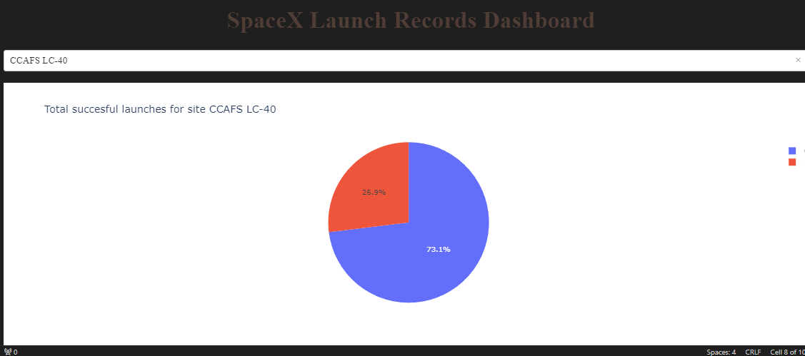
Success rate of CCAFS
KSC has the highest success rate with 76.9% and with the most successful launches
CCAF has the 2nd highest success rate with 73.1% and with the 2nd most successful launches

Slide 41
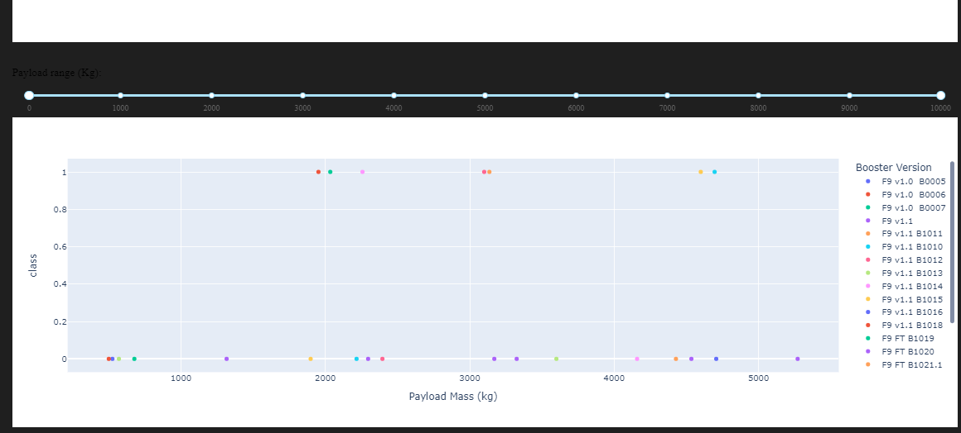
Landing outcomes of all boosters based on Payload Mass
We can see most boosters failing their landing

Slide 42

Section 5

Slide 43
Classification Accuracy
Bar chart of each model’s accuracy
Each model holds the same accuracy despite the model being different

Slide 44

Confusion Matrix
The Decision Tree moel had the highest accuracy of 83% on testing data but offered the minimal amount of false positives

Slide 45
Conclusions
The KSC launch site has the best launch outcomes.
• A decision tree is the best classifier for predicting launch outcomes
Launches had success with an increasing payload mass and increased flight trials

Slide 46
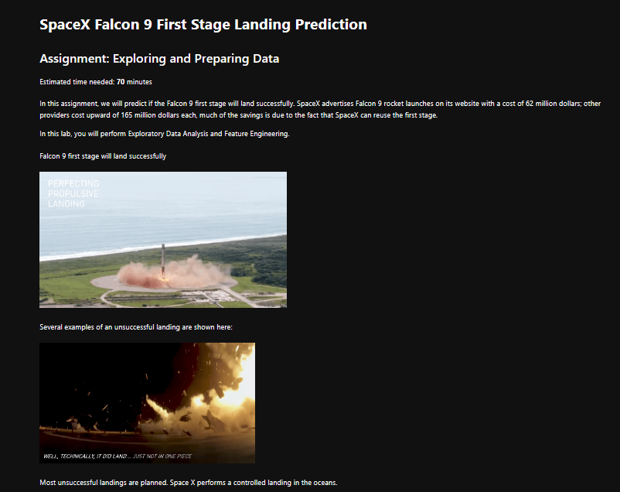
Appendix

Slide 47


